Slide 1
Defining Variables & Entering Data
Introduction to XLDA
MKTG2341 PC Lab Week 8

Slide 2
Reminder!
DATA ANALYSIS QUIZ
Week 11: Week of Nov 16.
In the Computer Lab.
Counts 5% of your grade.
Testing the content from today and next 2 weeks labs.

Slide 3
Today’s Agenda
Introduction to XLDA.
Creating a new XLDA data file.
Entering data to XLDA:
Manually
Copy-and Paste
Importing .csv file
Defining variables in XLDA.
Testing XLDA with the Utility function.

Slide 4
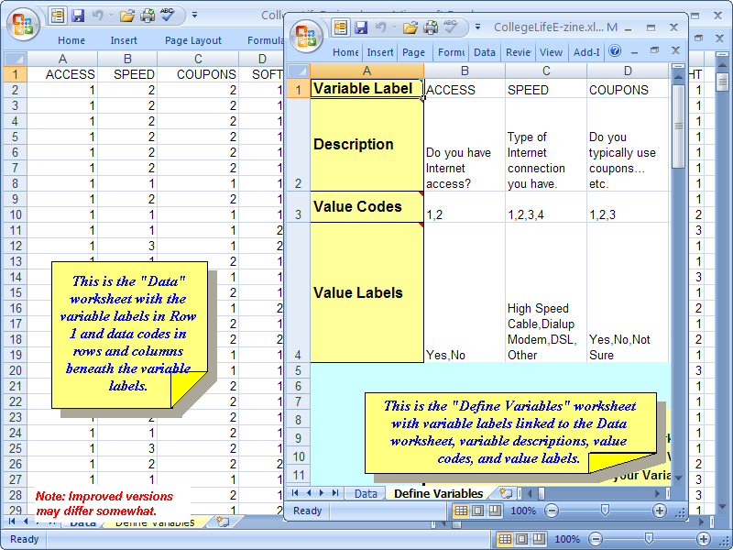
Introduction to XLDA

Slide 5
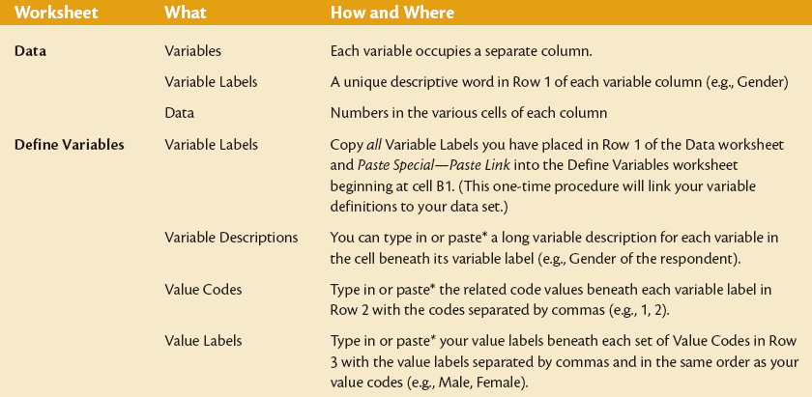
Introduction to XLDA

Slide 6
Preparing the XLDA File
8 STEPS:
In Excel: Open any XLDA file.
Save As: <YourName> in Personal Files.
In the Data Sheet delete all data. Save.
Enter your survey data.
Edit Variable Labels.
Link Variables in the Data sheet to Define Variables sheet.
Define the remaining codes and labels.
Clean-Up.

Slide 7
Steps 1-3: Starting the File
Open Excel: Open XLDA file
For Example: CollegeLifeE-zine.xlsm.
Save As: <Karen-XLDA> in Personal Files.
In the Data Sheet delete all data. Save.

Slide 8
Step 4: Enter Data
Three options for entering data:
Manually from paper based questionnaires.
Copy parts data from a CSV file or Excel spread sheet.
Import a CSV file (see warning).

Slide 9
Step 4: Enter Data
Before your data collection is completed, you may proceed to steps 5-7 and thereby creating an ‘empty’ database shell.
This is what is due in Week 9.
Once you have the data, you can ‘populate’ the database by completing Step 4
Only by using method 2 above.
NOT by using method 3.

Slide 10
Step 4: 1.Manual Entry of Data
In your empty Data sheet, type in the Variable names in the first row.
Each variable (question) gets its own column.
Each respondent is in a separate row.
Make sure that each questionnaire is numbered (no overlapping!)
Enter the data from the completed questionnaires: respondent 1 in row 2.
Save!

Slide 11
Step 4: 2. Copy-and-Paste Spreadsheet
Copy parts data from a CSV file or Excel spread sheet.
Open the data file: highlight and copy all the rows and columns you want.
Example from the Snap exported file:
Include row 1 with the variable names.
Exclude columns A and B as this is not important data.
Save!

Slide 12
Step 4: 3. Import CSV File
Often you have created the empty shell (defined all the variables) while waiting for the data collection to finish.
If this is your situation you can NOT use the Import command – because it will erase all the variable definitions.
WARNING

Slide 13
Step 4: 3. Import CSV File
WARNING
You can import a CSV file (from for example from an online survey).
Click:
XLDA | Utilities | Import Data
WARNING:
If you use the Import Data command, you will delete all the Variable Definitions. So if you have spent time defining the Variable Labels and codes use Copy-and-Paste instead.

Slide 14
Step 4: 3. Import CSV File
WARNING
You are first questioned about the nature of the data you wish to import.

Slide 15
Step 4: 3. Import CSV File
WARNING
Upon OK, the XL Data Analyst will provide a File Open menu that is limited to only comma separated variable (.csv) files.
Find the .csv file you exported from Snap.

Slide 16
Step 4: 3. Import CSV File
WARNING
May take a few seconds or longer, depending on the size of file.
Upon completion, 2 messages are issued:
Save!

Slide 17
Step 5: Edit Variable Labels
Variable Labels:
Must be unique, not repeated
Watch out for more than one “Other”
Change it to e.g., “Other Factors”
Must not have spaces in them.
Can be any length.
Can be letters and/or numbers.
Can use upper- and/or lower-case letters.

Slide 18
Step 6: Linking Variables
In Data sheet:
Highlight and copy the labels in Row 1.
In Define Variable sheet:
Click Paste Special
Check Paste Link
Click OK

Slide 19
Step 7: Defining Remaining Codes & Labels
In the Define Variables sheet under each Variable Label enter:
Variable Description
Value Codes
Value Labels

Slide 20
Step 7: 1. Variable Description
In Row 2, type long descriptions of the variables.
There is no limit to the length and any letter, number, punctuation mark or symbol is OK.
These descriptions will appear as heading in the XLDA tables, so don’t make them too long.
If complete variable descriptions do not show, block them and use Format Cells – Alignment – Wrap Text to make the complete descriptions appear.

Slide 21
Step 7: 2. Value Codes
Where the variables are coded with numbers enter in the code numbers, each separated by a comma.
Do not to have spaces between each value.
Clean-Up function will not detect spaces in the value codes, but XLDA will not work properly.
Warning:
Do not have spaces between each value code.
Notes:
Note: Do not to have spaces between each code
For example, if the user specifies 1, 2, then the XL Data Analyst will interpret the codes as “1” and “ 2” meaning that a “2” in the Data worksheet for that associated variable will be treated as different from a “ 2”code. Also, Clean-Up will not detect spaces in the value codes.

Slide 22
Step 7: 3. Value Labels
Value labels will appear in XLDA tables in place of the value codes.
Enter the corresponding value labels, each separated by a comma.
No spaces between the previous letter, the comma, and the next letter.
It is OK to have spaces inside a label.
Where variables are natural numbers such as number of times, dollar spent, etc, you don’t need value codes and value labels.
See warning on next slide

Slide 23
Step 7: 3. Value Labels
Warning:
If you use a comma as part of the Value Label, XLDA thinks it is a new label.
“$20,000” is read as two labels. Instead you should use a space “$20 000”
“Other, please specify” is read as two labels. Instead you should use a dash such as: “Other – please specify”.

Slide 24
Step 7: 3. Value Labels Example
Please indicate which of the following packaging colours you like the most:
Red
Green
Light Blue
Purple
NO space between
Space inside OK
Value Codes:
1,2,3,4
Value Labels:
Red,Green,Light Blue,Purple

Slide 25
Clean-Up
Step 8:Clean-Up
To Make sure that all the links and definitions work properly, we use the Utility function Clean-Up.
Click: XLDA | Utilities | Clean-up

Slide 26
Clean-Up
A text box appears
Click Yes

Slide 27
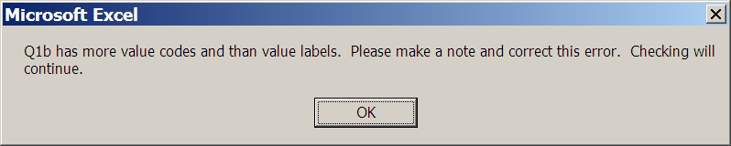
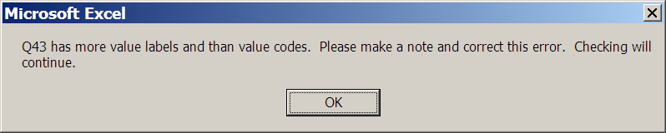
Clean-Up
You may receive an error message.
Make a note of the variable and the error.
Click OK
Next error message will pop up

Slide 28
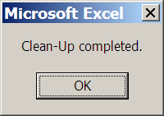
Clean-Up
Once all the variables have been checked a message box will tell you so.
Now go back and fix all the variables
Use the Utility function again.
Continue until you don’t get any more errors.

Slide 29
Next Steps …
Following the steps in this lab, you have learned how to prepare the empty XLDA shell.
The next step is to populate the file with your data as soon as it has been collected.
Now you are ready to analyze the data – the topic of the next two PC Labs.

Slide 30
Reminder!
Excel Database Structure (empty shell) due in PC Lab 9 in Share-in.
One file per group.

Slide 31
Over to you …
Open an XLDA file.
Rename and save in your personal space.
Based on your group’s questionnaire, define:
Variable Labels
Variable Description
Value Codes
Value Labels
Use the Clean-Up function.
Save in Share-In.
If you don’t have your questionnaire use the Snap Crocodile file.

